Slide 1
Transaction Processing Concept
Unit - 5

Slide 2
Topics to be covered
Introducing Transactions,
Processing a transaction and State of transaction,
ACID property of a transaction

Slide 3
Single-User Versus Multiuser system
Single-User:
At most one user at a time can use the system
Mostly restricted to personal computer system
Multi-User system:
Many users can use the system, and access the database concurrently
Eg. Airline reservation system, banking system, stock market, supper market etc…
In this system hundred and thousands of users are operating on the database by submitting transactions concurrently to the system.

Slide 4
Multiprogramming and Parallel Processing
Multiprogramming allows the operating system of the computer to execute multiple programs / processes at the same time
A single CPU can execute only one process at a time
Multiprogramming operating system executes some command from one process, then suspend the process and execute commands from next process…and so on
A process is resumed at the point where it was suspended, whenever it gets turn to use CPU again
If the computer has multiple CPUs, parallel processing of multiple processes is possible
Most of the systems have interleaved concurrency – i.e. primary resource accessed concurrently by interactive users or application programs, which are constantly retrieving information from / and modifying the DB.

Slide 5
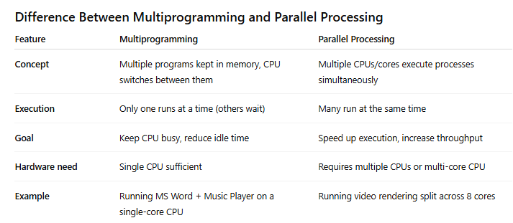
Multiprogramming and Parallel Processing

Slide 6
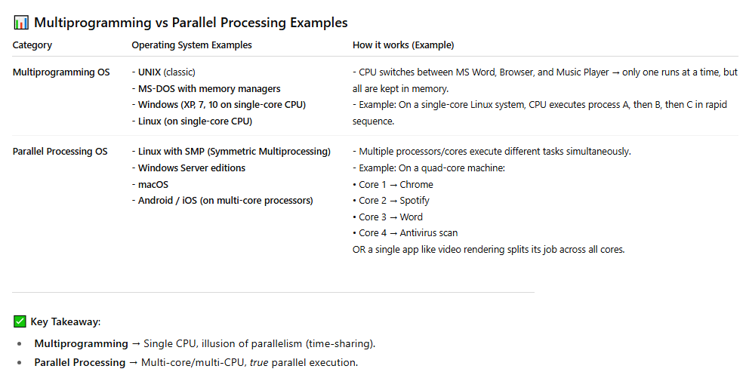
Multiprogramming and Parallel Processing

Slide 7
Transactions, Database Items, Read and Write Operations and DBMS Buffers
A transaction is an executing program that forms a logical unit of database processing.
A transaction includes one or more database access operations—these can include insertion, deletion, modification (update), or retrieval operations.
One way of specifying the transaction boundaries is by specifying explicit begin transaction and end transaction statements in an application program
A single application program may contain more than one transaction if it contains several transaction boundaries
If the database operations in a transaction do not update the database but only retrieve data, the transaction is called a read-only transaction; otherwise it is known as a read-write transaction.
A database is basically represented as a collection of named data items. The size of a data item is called its granularity.
A data item can be a database record, but it can also be a larger unit such as a whole disk block, or even a smaller unit such as an individual field (attribute) value of some record in the database

Slide 8
Access operations that a transaction can include are as follows:
read_item(X)
Reads a database item named X into a program variable. To simplify our notation, we assume that the program variable is also named X.
write_item(X).
Writes the value of program variable X into the database item named X

Slide 9
Executing a read_item(X) command includes the following steps:
1. Find the address of the disk block that contains item X.
2. Copy that disk block into a buffer in main memory (if that disk block is not already in some main memory buffer). The size of the buffer is the same as the disk block size.
3. Copy item X from the buffer to the program variable named X.
Executing a write_item(X) command includes the following steps:
1. Find the address of the disk block that contains item X.
2. Copy that disk block into a buffer in main memory (if that disk block is not already in some main memory buffer).
3. Copy item X from the program variable named X into its correct location in the buffer.
4. Store the updated disk block from the buffer back to disk (either immediately or at some later point in time).

Slide 10
Transaction and System Concept
A transaction is an atomic unit of work that should either be completed in its entirety or not done at all.
For recovery purposes, the system needs to keep track of when each transaction starts, terminates, and commits, or aborts
The recovery manager of the DBMS needs to keep track of the following operations:
BEGIN_TRANSACTION. This marks the beginning of transaction execution.
READ or WRITE. These specify read or write operations on the database items that are executed as part of a transaction.
END_TRANSACTION. This specifies that READ and WRITE transaction operations have ended and marks the end of transaction execution. However, at this point it may be necessary to check whether the changes introduced by the transaction can be permanently applied to the database (committed) or whether the transaction has to be aborted because it violates serializability or for some other reason.
COMMIT_TRANSACTION. This signals a successful end of the transaction so that any changes (updates) executed by the transaction can be safely committed to the database and will not be undone.
ROLLBACK (or ABORT). This signals that the transaction has ended unsuccessfully, so that any changes or effects that the transaction may have applied to the database must be undone.

Slide 11
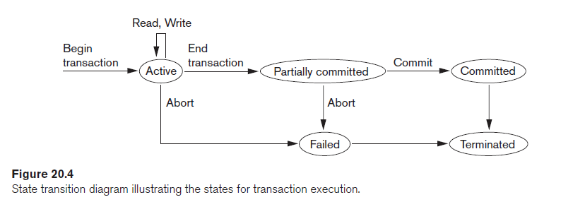

Slide 12
Desirable Properties of Transactions
The following are the ACID properties:
Atomicity. A transaction is an atomic unit of processing; it should either be performed in its entirety or not performed at all.
Consistency preservation. A transaction should be consistency preserving, meaning that if it is completely executed from beginning to end without interference from other transactions, it should take the database from one consistent state to another.
Isolation. A transaction should appear as though it is being executed in isolation from other transactions, even though many transactions are executing concurrently. That is, the execution of a transaction should not be interfered with by any other transactions executing concurrently.
Durability or permanency. The changes applied to the database by a committed transaction must persist in the database. These changes must not be lost because of any failure.

Slide 13
Schedules of Transaction
A schedule (or history) S of n transactions T1, T2, … , Tn is an ordering of the operations of the transactions.
Operations from different transactions can be interleaved in the schedule S.
For each transaction Ti that participates in the schedule S, the operations of Ti in S must appear in the same order in which they occur in Ti.
For the purpose of recovery and concurrency control, mainly read_item and write_item operations of the transactions, as well as the commit and abort operations are considered here.
A shorthand notation for describing a schedule uses the symbols b, r, w, e, c, and a for the operations begin_transaction, read_item, write_item, end_transaction, commit, and abort, respectively, and appends as a subscript the transaction id (transaction number) to each operation in the schedule

Slide 14
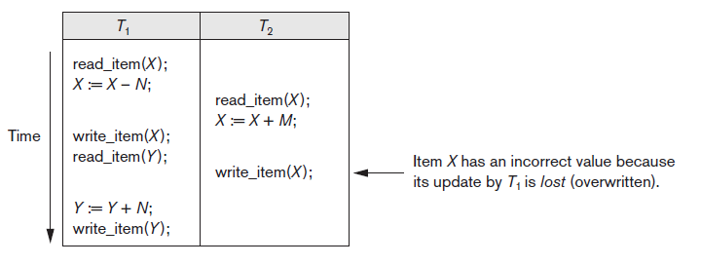
Example
Schedule for the following transaction can be written as:
S: r1(X); r2(X); w1(X); r1(Y); w2(X); w1(Y);
Highlighted operations are conflicting operations in the schedule – read-write conflict

Slide 15
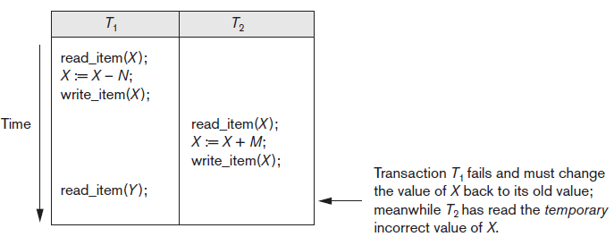
Example
Schedule for the following transaction can be written as:
S: r1(X); w1(X); r2(X); w2(X); r1(Y); a1;
Highlighted operations are conflicting operations in the schedule – write-write conflict

Slide 16
Conflicting Operations in a Schedule
Two operations in a schedule are said to conflict if they satisfy all three of the following conditions:
(1) they belong to different transactions;
(2) they access the same item X; and
(3) at least one of the operations is a write_item(X).
Two operations are conflicting if changing their order can result in a different outcome.

Slide 17
Complete Schedule
A schedule S of n transactions T1, T2, … , Tn is said to be a complete schedule if the following conditions hold:
1. The operations in S are exactly those operations in T1, T2, … , Tn, including a commit or abort operation as the last operation for each transaction in the schedule.
2. For any pair of operations from the same transaction Ti, their relative order of appearance in S is the same as their order of appearance in Ti.
3. For any two conflicting operations, one of the two must occur before the other in the schedule

Slide 18
Characterizing Schedules based on Recoverability
Once a transaction T is committed, it should never be necessary to roll back T.
This ensures that the durability property of transactions is not violated.
The schedules that theoretically meet this criterion are called recoverable schedules
A schedule where a committed transaction may have to be rolled back during recovery is called nonrecoverable schedules
and hence should not be permitted by the DBMS

Slide 19
The condition for a recoverable schedule is as follows
A schedule S is recoverable if no transaction T in S commits until all transactions T′ that have written some item X that T reads have committed.
A transaction T reads from transaction T′ in a schedule S if some item X is first written by T′ and later read by T.
In addition, T′ should not have been aborted before T reads item X, and there should be no transactions that write X after T′ writes it and before T reads it
Eg. Consider the schedule Sa’ given below, which is the same as schedule Sa except that two commit operations have been added to Sa:
Sa’ : r1(X); r2(X); w1(X); r1(Y); w2(X); c2; w1(Y); c1;
Sa’ is now called recoverable schedule, even though it suffers from the lost update problem

Slide 20
Example:
Consider the two (partial) schedules Sc and Sd that follow:
Sc: r1(X); w1(X); r2(X); r1(Y); w2(X); c2; a1;
Non Recoverable
Sd: r1(X); w1(X); r2(X); r1(Y); w2(X); w1(Y); c1; c2;
Recoverable
Se: r1(X); w1(X); r2(X); r1(Y); w2(X); w1(Y); a1; a2;
Recoverable with cascading rollback

Slide 21
Characterizing Schedules Based on Serializability
Suppose that two users—for example, two airline reservations agents—submit to the DBMS transactions T1 and T2 at approximately the same time.
If no interleaving of operations is permitted, there are only two possible outcomes:
1. Execute all the operations of transaction T1 (in sequence) followed by all the operations of transaction T2 (in sequence).
2. Execute all the operations of transaction T2 (in sequence) followed by all the operations of transaction T1 (in sequence).
These two schedules—called serial schedules

Slide 22
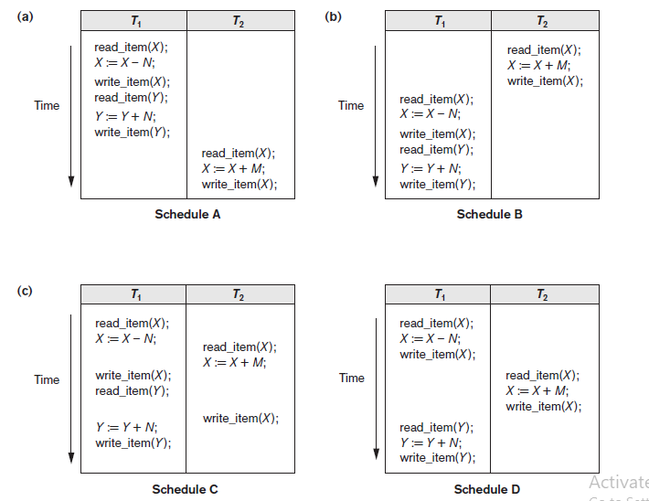
Schedule A and B are serial schedules
Schedule C is Non-Serializable Schedule
Schedule D is called as serializable schedule

Slide 23
Concurrency control
Lock-Based Protocols
Timestamp-Based Protocols
Validation-Based Protocols

Slide 24
Lock-Based Protocols
A lock is a mechanism to control concurrent access to a data item
Data items can be locked in two modes :
1. exclusive (X) mode. Data item can be both read as well as
written. X-lock is requested using lock-X instruction.
2. shared (S) mode. Data item can only be read. S-lock is
requested using lock-S instruction.
Lock requests are made to concurrency-control manager. Transaction can proceed only after request is granted.

Slide 25
Lock-Based Protocols (Cont.)
Lock-compatibility matrix
A transaction may be granted a lock on an item if the requested lock is compatible with locks already held on the item by other transactions
Any number of transactions can hold shared locks on an item,
But if any transaction holds an exclusive on the item no other transaction may hold any lock on the item.
Notes:
If a lock cannot be granted, the requesting transaction is made to wait till all incompatible locks held by other transactions have been released. The lock is then granted.

Slide 26
Lock-Based Protocols (Cont.)
Example of a transaction performing locking:
T₂: lock-S(A);
read (A);
unlock(A);
T1: lock-S(B);
read (B);
unlock(B);
display(A+B)
Locking as above is not sufficient to guarantee serializability

Slide 27
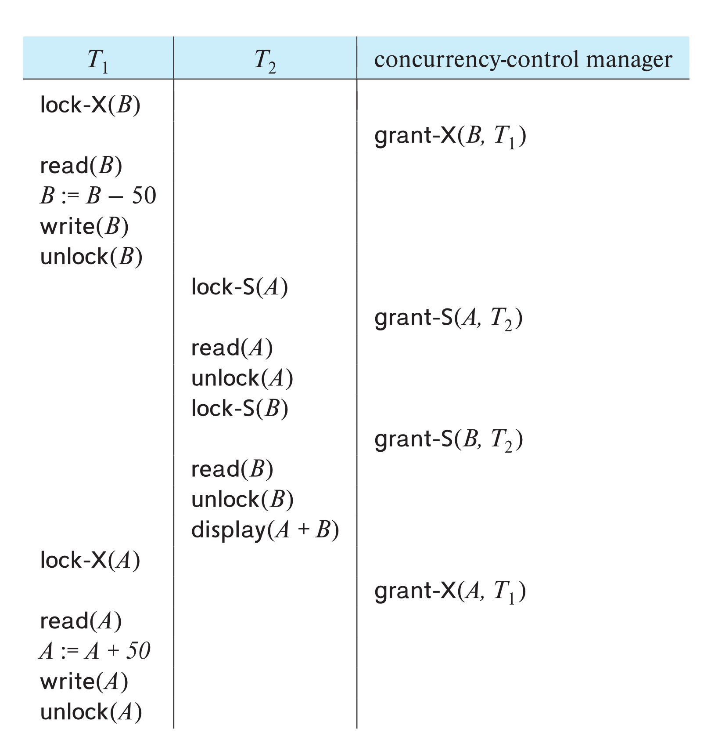
Schedule With Lock Grants
Assume grant happens just before the next instruction following lock request
This schedule is not serializable (why?)
A locking protocol is a set of rules followed by all transactions while requesting and releasing locks.
Locking protocols enforce serializability by restricting the set of possible schedules.

Slide 28
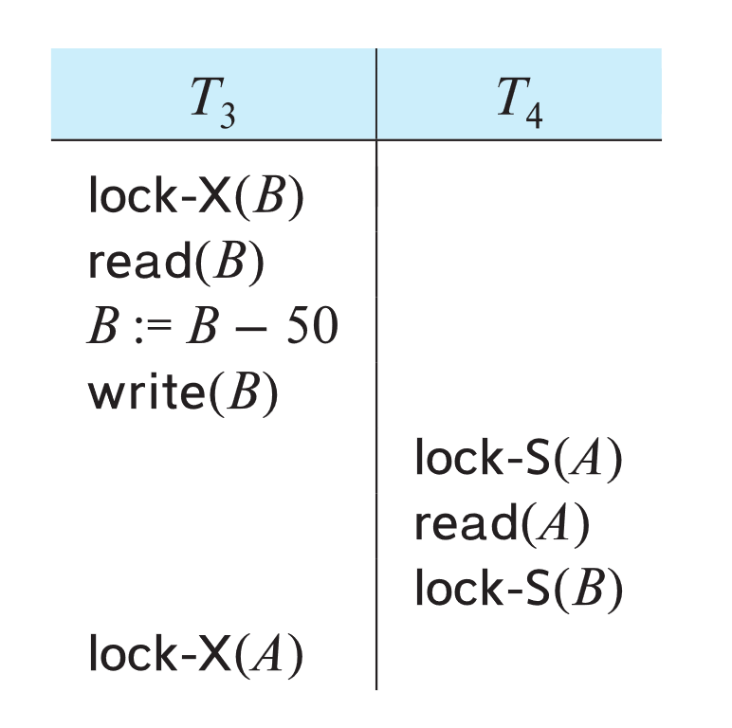
Deadlock
Consider the partial schedule
Neither T₃ nor T₄ can make progress — executing lock-S(B) causes T₄ to wait for T₃ to release its lock on B, while executing lock-X(A) causes T₃ to wait for T₄ to release its lock on A.
Such a situation is called a deadlock.
To handle a deadlock one of T₃ or T₄ must be rolled back and its locks released.

Slide 29
Deadlock (Cont.)
The potential for deadlock exists in most locking protocols. Deadlocks are a necessary evil.
Starvation is also possible if concurrency control manager is badly designed.
For example:
A transaction may be waiting for an X-lock on an item, while a sequence of other transactions request and are granted an S-lock on the same item.
The same transaction is repeatedly rolled back due to deadlocks.
Concurrency control manager can be designed to prevent starvation.

Slide 30
The Two-Phase Locking Protocol
A protocol which ensures conflict-serializable schedules.
Phase 1: Growing Phase
Transaction may obtain locks
Transaction may not release locks
Phase 2: Shrinking Phase
Transaction may release locks
Transaction may not obtain locks
The protocol assures serializability. It can be proved that the transactions can be serialized in the order of their lock points (i.e., the point where a transaction acquired its final lock).
Locks
Time

Slide 31
The Two-Phase Locking Protocol (Cont.)
Two-phase locking does not ensure freedom from deadlocks
Extensions to basic two-phase locking needed to ensure recoverability of freedom from cascading roll-back
Strict two-phase locking: a transaction must hold all its exclusive locks till it commits/aborts.
Ensures recoverability and avoids cascading roll-backs
Rigorous two-phase locking: a transaction must hold all locks till commit/abort.
Transactions can be serialized in the order in which they commit.
Most databases implement rigorous two-phase locking, but refer to it as simply two-phase locking

Slide 32
The Two-Phase Locking Protocol (Cont.)
Two-phase locking is not a necessary condition for serializability
There are conflict serializable schedules that cannot be obtained if the two-phase locking protocol is used.
In the absence of extra information (e.g., ordering of access to data), two-phase locking is necessary for conflict serializability in the following sense:
Given a transaction T_{i} that does not follow two-phase locking, we can find a transaction T_{j} that uses two-phase locking, and a schedule for T_{i} and T_{j} that is not conflict serializable.

Slide 33
Locking Protocols
Given a locking protocol (such as 2PL)
A schedule S is legal under a locking protocol if it can be generated by a set of transactions that follow the protocol
A protocol ensures serializability if all legal schedules under that protocol are serializable

Slide 34
Lock Conversions
Two-phase locking protocol with lock conversions:
– Growing Phase:
can acquire a lock-S on item
can acquire a lock-X on item
can convert a lock-S to a lock-X (upgrade)
– Shrinking Phase:
can release a lock-S
can release a lock-X
can convert a lock-X to a lock-S (downgrade)
This protocol ensures serializability

Slide 35
Automatic Acquisition of Locks
A transaction T_{i} issues the standard read/write instruction, without explicit locking calls.
The operation read(D) is processed as:
if T_{i} has a lock on D
then
read(D)
else begin
if necessary wait until no other
transaction has a lock-X on D
grant T_{i} a lock-S on D;
read(D)
end

Slide 36
Automatic Acquisition of Locks (Cont.)
The operation write(D) is processed as:
if T_{i} has a lock-X on D
then
write(D)
else begin
if necessary wait until no other trans. has any lock on D,
if T_{i} has a lock-S on D
then
upgrade lock on D to lock-X
else
grant T_{i} a lock-X on D
write(D)
end;
All locks are released after commit or abort

Slide 37
Deadlock Handling
System is deadlocked if there is a set of transactions such that every transaction in the set is waiting for another transaction in the set.

Slide 38
Deadlock Handling
Deadlock prevention protocols ensure that the system will never enter into a deadlock state. Some prevention strategies:
Require that each transaction locks all its data items before it begins execution (pre-declaration).
Impose partial ordering of all data items and require that a transaction can lock data items only in the order specified by the partial order (graph-based protocol).

Slide 39
More Deadlock Prevention Strategies
wait-die scheme — non-preemptive
Older transaction may wait for younger one to release data item.
Younger transactions never wait for older ones; they are rolled back instead.
A transaction may die several times before acquiring a lock
wound-wait scheme — preemptive
Older transaction wounds (forces rollback) of younger transaction instead of waiting for it.
Younger transactions may wait for older ones.
Fewer rollbacks than wait-die scheme.
In both schemes, a rolled back transactions is restarted with its original timestamp.
Ensures that older transactions have precedence over newer ones, and starvation is thus avoided.

Slide 40
Deadlock prevention (Cont.)
Timeout-Based Schemes:
A transaction waits for a lock only for a specified amount of time. After that, the wait times out and the transaction is rolled back.
Ensures that deadlocks get resolved by timeout if they occur
Simple to implement
But may roll back transaction unnecessarily in absence of deadlock
Difficult to determine good value of the timeout interval.
Starvation is also possible

Slide 41
Deadlock Detection
Wait-for graph
Vertices: transactions
Edge from T_{i} →T_{j}. : if T_{i} is waiting for a lock held in conflicting mode byT_{j}
The system is in a deadlock state if and only if the wait-for graph has a cycle.
Invoke a deadlock-detection algorithm periodically to look for cycles.
Wait-for graph without a cycle
Wait-for graph with a cycle

Slide 42
Deadlock Recovery
When deadlock is detected :
Some transaction will have to rolled back (made a victim) to break deadlock cycle.
Select that transaction as victim that will incur minimum cost
Rollback -- determine how far to roll back transaction
Total rollback: Abort the transaction and then restart it.
Partial rollback: Roll back victim transaction only as far as necessary to release locks that another transaction in cycle is waiting for
Starvation can happen (why?)
One solution: oldest transaction in the deadlock set is never chosen as victim

Slide 43
Using Commit
A commit ends the current transaction and makes any changes permanent, made during transaction
Syntax:
COMMIT;

Slide 44
Rollback
A rollback does exactly opposite to Commit.
It ends the transaction but undoes any changes made during the transaction
All transaction locks acquired on tables are released
Syntax:
ROLLBACK [WORK] [TO [SAVEPOINT] <SavePoint Name>];

Slide 45
Creating SavePoint
Save point marks and saves the current point in the processing of a transaction.
When the SavePoint is used with the rollback statement, part of a transaction can be undone
An active SavePoint is one that is specified since the last COMMIT or ROLLBACK
Syntax:
SAVEPOINT <SavePoint Name>

Slide 46
Recovery System
Failure Classification
Transaction failure.
There are two types of errors that may cause a transaction to fail:
◦ Logical error.
The transaction can no longer continue with its normal execution because of some internal condition, such as bad input, data not found, overflow, or resource limit exceeded.
◦ System error.
The system has entered an undesirable state (for example, deadlock), as a result of which a transaction cannot continue with its normal execution. The transaction, however, can be re-executed at a later time.

Slide 47
2. System crash.
There is a hardware malfunction, or a bug in the database – called fail-stop assumption
Software or the operating system, that causes the loss of the content of volatile storage, and brings transaction processing to a halt.
SOLUTION : Well-designed systems have numerous internal checks, at the hardware and the software level, that bring the system to a halt when there is an error
Disk failure - A disk block loses its content as a result of either a head crash or failure during a data-transfer operation.
SOLUTION: Copies of the data on other disks, or archival backups on tertiary media, such as DVD or tapes, are used to recover from the failure.

Slide 48
Recovery algorithms, have two parts:
1. Actions taken during normal transaction processing to ensure that enough information exists to allow recovery from failures.
2. Actions taken after a failure to recover the database contents to a state that ensures database consistency, transaction atomicity, and durability.

Slide 49
Log Records
The most widely used structure for recording database modifications is the log.
The log is a sequence of log records, recording all the update activities in the database.
There are several types of log records. An update log record describes a single database write.
It has these fields: (Next slide)

Slide 50
Log Record Fields:
Transaction identifier, which is the unique identifier of the transaction that
performed the write operation.
Data-item identifier, which is the unique identifier of the data item written.
Typically, it is the location on disk of the data item, consisting of the block identifier of the block on which the data item resides, and an offset within the block.
Old value, which is the value of the data item prior to the write.
New value, which is the value that the data item will have after the write.

Slide 51
A recovery algorithm must take into account a variety of factors, including:
The possibility that a transaction may have committed although some of its database modifications exist only in the disk buffer in main memory and not in the database on disk.
The possibility that a transaction may have modified the database while in the active state and, as a result of a subsequent failure, may need to abort.
Because all database modifications must be preceded by the creation of a log record, the system has available both the old value prior to the modification of the data item and the new value that is to be written for the data item.
This allows the system to perform undo and redo operations as appropriate.
Undo using a log record sets the data item specified in the log record to the old value.
Redo using a log record sets the data item specified in the log record to the new value.

